Slide 1
Problem Solving in R
20-Jul-2024
By Brice Richard

Slide 2
Agenda
Introduction
Strategy vs Tactics
Problem-Solving R in Context
Problem-Solving Philosophy
In Learning: Process Model Considerations
Data Perspectives & Dynamics
Workflow Structures
Examples
Conclusion
2

Slide 3

www.goshenpublishers.com/brice-richard
Brice Richard |
wem3mew@msn.com
Introduction
Been in the technology space since 1999
Started career as a Software Engineer – Became a Data Scientist in 2019
Currently working as a Data Scientist for a company called Noblis
Began studying R in 2015
Developed a global monitoring knowledge-base tool used to identify new and emerging technologies in R called PEGUSYS
Published an introductory book on R in mid 2021 called “Conquering R Basics” (on Amazon)

Slide 4
Strategy vs. tactics
Problem Solving LEARNING R vs Problem Solving Applying R
You Must Learn R Before You Can Apply R!
STRATEGY: Understand the underlying framework and first principles of R
TACTICS: Defines the technical skill sets needed to develop process models and apply working solutions to data problems
4

Slide 5
STRATEGY
+ TACTICS
5
Problem Solving
In learning R
Productivity Considerations
Code Base
Represents a series of targeted articles designed to describe, in detail, the functional capabilities captured in the database
Database
A structured means for storing and organizing R functions in a way that facilitates identifying and applying programmatic possibilities
R Package Documentation
An organized repository of data comprising folders, files, and plots that support the Code Base and the Database
Stack Overflow is Not Enough!
Use Generative AI
Reading Materials
Tutorial Videos

Slide 6
Problem Solving perspectives in R
STRATEGY
The essence of problem solving in R relies on the ability to connect data to visualization
Data Narrative
What story is being told with the data?
Insights
What questions does the data answer?
Actionability
Execute on the insights discovered
Improves the decision-making process

Slide 7
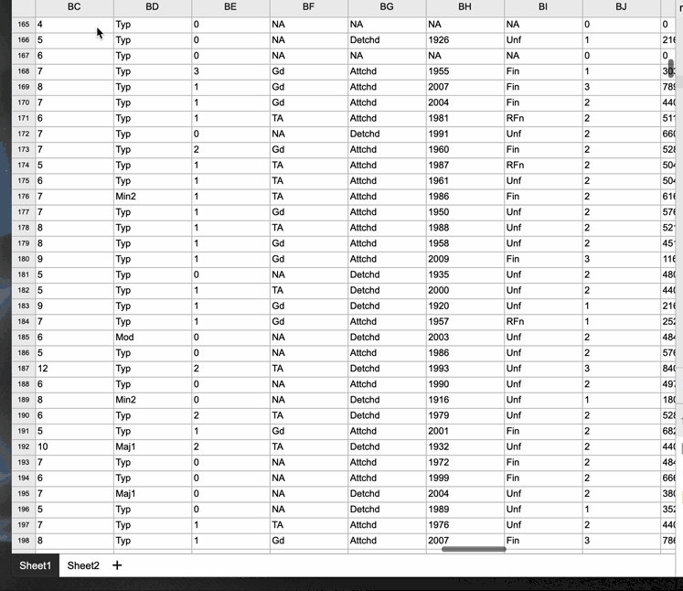


Data to-plot
High level process model
Dataset
Code
Plot
Workflow Structure

Slide 8
Problem Solving
workflow structures in R
First Principle of Data Science
TACTICS
The Meta-Dynamics of all Data can be Narrowed Down into Fundamentally Three Categories Through Which an Interpretation is Acquired
Patterns | Outliers | Anomalies
DATA STRUCTURE & CONVERSION
PROGRAMATC PLOT DEVELOPMENT
DATA NARRATIVE CONSTRUCTION
INSIGHT DISCOVERY
Must understand how to match the type and structure of a dataset object to a particular plot type
Must understand both the R code syntax (typically achieved through functions) and its correct execution sequence to generate a plot
Must understand the various statistical plot types and the ways in which they are generally applied
Must understand the context in which a particular plot type is being considered relative to the problem being solved

Slide 9

Examples

Slide 10
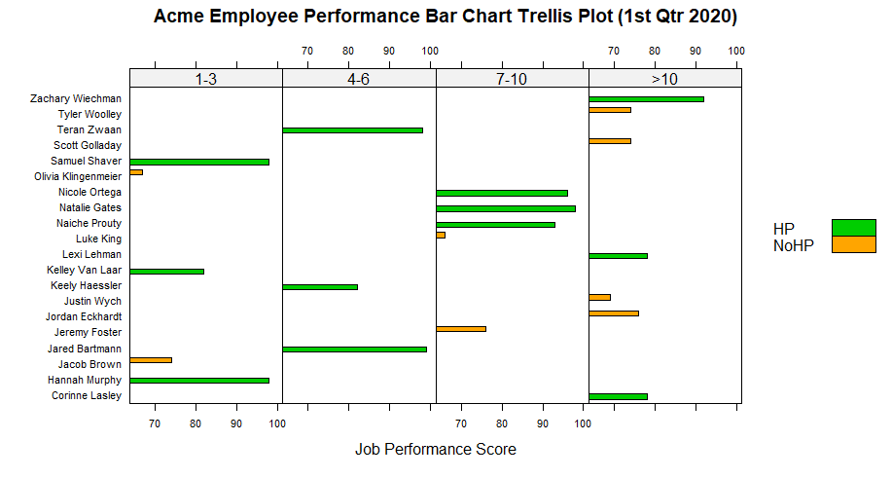
One Line of R code can develop a data narrative
WHO ARE THE LOWEST PERFORMING EMPLOYEES?

Slide 11
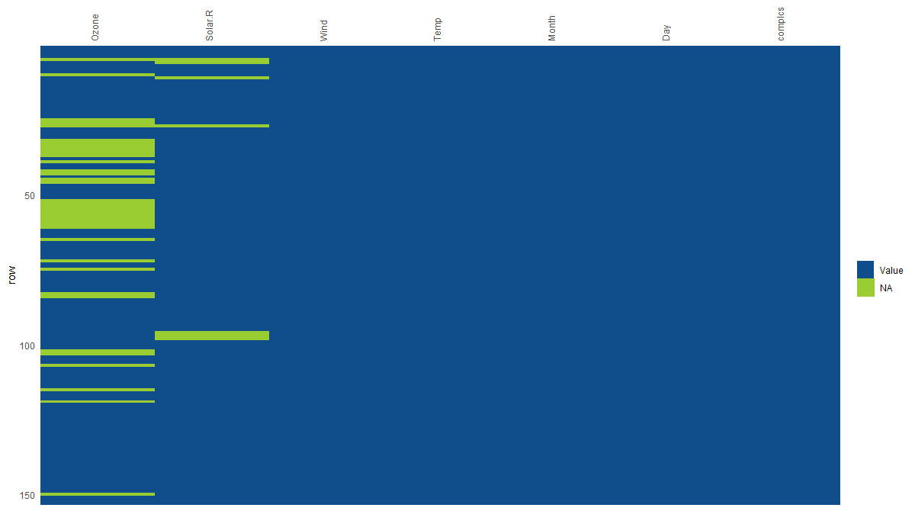
WHICH VARIABLE HAS THE MOST MISSING DATA?

Slide 12
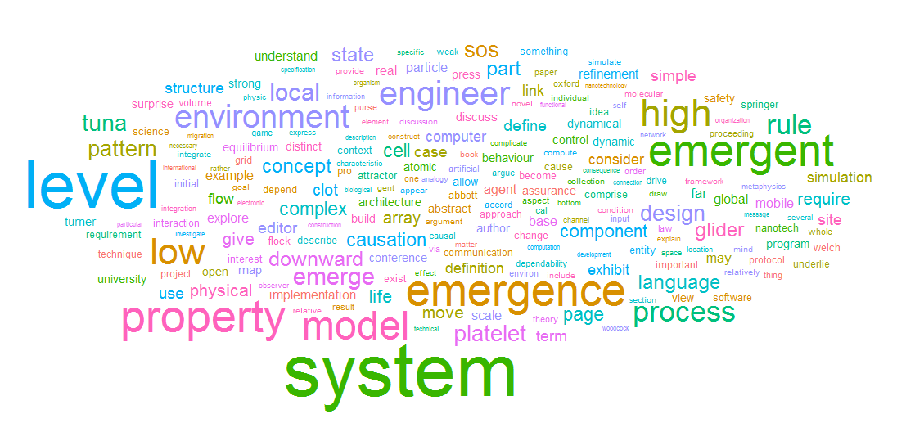
WORDCLOUD PLOT
WHAT IS THE THEME OF THE DOCUMENT?

Slide 13
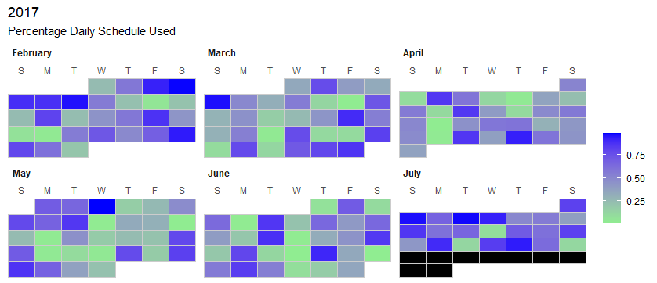
Where % is a Measure of Productivity…
What Days Hold the Highest Daily Percentage?
What Days Hold the Lowest?
Is There a Pattern?

Slide 14
Advanced Ideas in R
Advanced Skill Sets in R Can Generate
Remarkable Data Artifacts
Collapsible Tree
Timeline Visualization
Coincidence Modeling

